Slide 1
Samsung Innovation Campus

Slide 2
INTRODUCTION
TEAM NO : 12
PROJECT NAME : ICU VIRTUAL VISIT
DOMAIN NAME : HEALTH CARE
Team Member Name And Role
NAME | ROLE
KAVANA J | TEAM LEADER
BHOOMIKA MS | TEAM MEMBER
VARSHITHA G | TEAM MEMBER
MUSKAN KHANUM | TEAM MEMBER

Slide 3
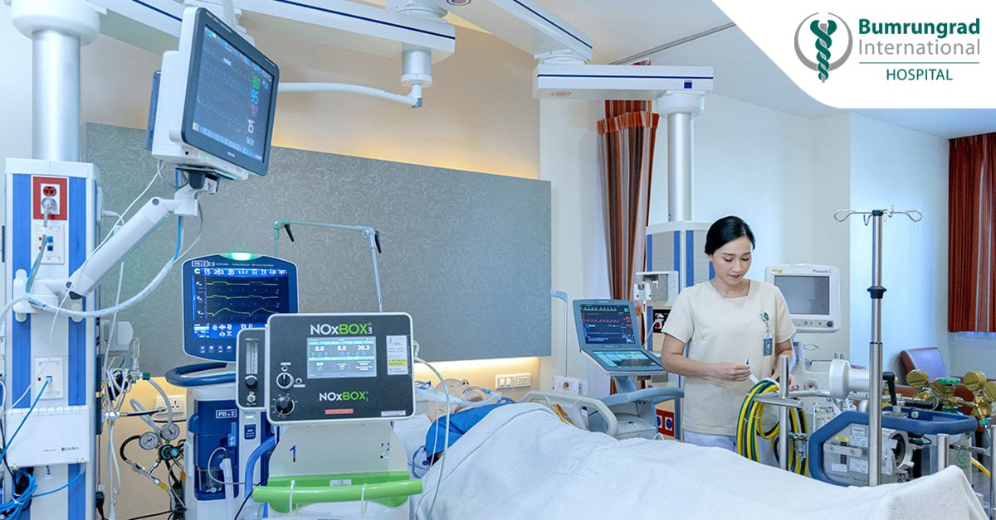
PROTOYPE OF THE PROJECT

Slide 4
DESIGN THINKING
It includes the communication between the family members with the loved ones.
It reduces the stress while travelling to the hospital.
It includes family involvement patient care.
Allowing patients and their families to ask questions of healthcare providers in real-time during virtual visit.
It is the solution of key challenges and pain points faced by the patient and family when using the ICU virtual visit plaforms.

Slide 5
Title
Slide Title
Level1
Level2
Please edit project name and page number in slide master

